Slide 1
IBM SkillsBuild for Adult Learners - Data Analytics
Data Analytics Internship Program 2024 Final Project Presentation
Project Name: Sustainable Food Production and Usage
Team Name: Data Wizards (IBM3883)
College Name: University School of Information, Communication and Technology, Guru Gobind
Singh Indraprastha University

Slide 2
Team Members
Aditya Pandey
Parth Gupta
Nikhil Kumar
Pankaj Kumar Verma
Roshan
Bhavdeep Singh Nijhawan

Slide 3
Introduction
Overview of the Project: The goal of this project is to analyze food production, availability, and wastage to gain insights into the efficiency of food production and distribution systems. The project will involve data collection, analysis, and visualization to provide a comprehensive understanding of food production, availability, and wastage. Based on the analysis and visualization, the project will provide insights into the efficiency of food production and distribution systems and make recommendations for reducing food waste and improving food security.
Objective: By understanding the patterns and trends in food production and wastage, we can identify areas for improvement and develop strategies to reduce food waste and ensure food security. By analyzing food production, availability, and wastage, we can gain insights into the efficiency of food systems, identify areas for improvement, and develop strategies to reduce waste and ensure food security. This project will involve data collection, analysis, and visualization to provide a comprehensive understanding of food production, availability, and wastage.

Slide 4
Problem Identification
Problem Statement: Food production, availability, and wastage are critical issues that impact food security, sustainability, and the environment. According to the Food and Agriculture Organization (FAO), approximately one-third of all food produced for human consumption is lost or wasted globally each year, which amounts to about 1.3 billion tons of food. This food waste has significant economic, social, and environmental impacts, making it a pressing issue that requires urgent attention.
Significance of the Problem: Food waste has significant consequences for the economy, society, and the environment. Economically, food waste costs billions of dollars each year in production, processing, and distribution costs. Socially, food waste contributes to food insecurity and poverty, as millions of people around the world lack access to sufficient food. Environmentally, food waste contributes to greenhouse gas emissions, deforestation, and water scarcity, making it a critical issue for sustainable development.
Relevant SDGs: The United Nations Sustainable Development Goals (SDGs) provide a framework for addressing global challenges, including food production, availability, and wastage. The following SDGs are particularly relevant to this project:

Slide 5
Problem Identification
SDG 2: Zero Hunger - The project aims to reduce food waste and improve food security, which are critical components of achieving zero hunger.
SDG 12: Responsible Consumption and Production - The project promotes responsible consumption and production patterns by reducing food waste and promoting sustainable practices.
SDG 13: Climate Action - The project addresses climate change by reducing greenhouse gas emissions associated with food waste.
SDG 15: Life on Land - The project promotes sustainable land use and resource management by reducing food waste and promoting efficient food production systems.

Slide 6
Data Collection
Sources of Data: The data for this project will be collected from a variety of sources, including:
Government databases and reports
Agricultural and food production reports
Food waste studies and surveys
Non-governmental organizations (NGOs) and international organizations
Academic research and publications
Data Description: The data will include information on food production, availability, and wastage, as well as demographic, economic, and environmental data. The data may include information on crop yields, food prices, food distribution systems, food waste rates, and greenhouse gas emissions.

Slide 7
Data Collection
Data Collection Methods: The data will be collected using a variety of methods, including:
Data mining and web scraping
Surveys and questionnaires
Interviews and focus groups
Secondary data analysis
Literature reviews and academic research

Slide 8
Data Preprocessing
Data Cleaning Methods: Data cleaning is an essential step in the data analysis process, which involves identifying and correcting errors, inconsistencies, and inaccuracies in the data. The data cleaning methods for this project will include:
Identifying and correcting data entry errors
Removing duplicates and irrelevant data
Standardizing data formats and units
Handling outliers and anomalies
Checking for data integrity and consistency
Handling Missing Values: Missing data is a common problem in data analysis, which can affect the accuracy and reliability of the results. The missing values will be handled using the following methods:
Imputation: Replacing missing values with estimated values based on other data points
Deletion: Removing data points with missing values
Predictive modeling: Using machine learning algorithms to predict missing values

Slide 9
Data Preprocessing
Data Transformation Techniques: Data transformation techniques are used to convert the data into a format that is suitable for analysis. The data transformation techniques for this project will include:
Scaling and normalization: Transforming data to a common scale or range
Aggregation: Combining data points into larger units
Disaggregation: Breaking down data points into smaller units
Feature engineering: Creating new features or variables based on existing data
Dimensionality reduction: Reducing the number of variables or features in the data

Slide 10
Data Analysis
Analytical Tools and Methods Used: Kaggle
Libraries and Tools:
NumPy: Used for numerical operations and array handling.
Pandas: Utilized for data manipulation and analysis, including reading CSV files, handling missing data, calculating statistics, and mapping categorical data to numerical values.
Seaborn and Matplotlib: Employed for data visualization, such as creating histograms and scatter plots.
Data Analysis and Cleaning:
Data Inspection: Using df.shape, df.head(), and df.info() to understand the structure and content of the dataset.
Missing Values: Checked using pd.isnull(df).sum().
Statistical Measures: Calculated mean and median for various columns to understand central tendencies (mean() and median() functions).
Data Mapping: Categorical data in the 'Confidence in estimate' column was mapped to numerical values for analysis purposes.

Slide 11
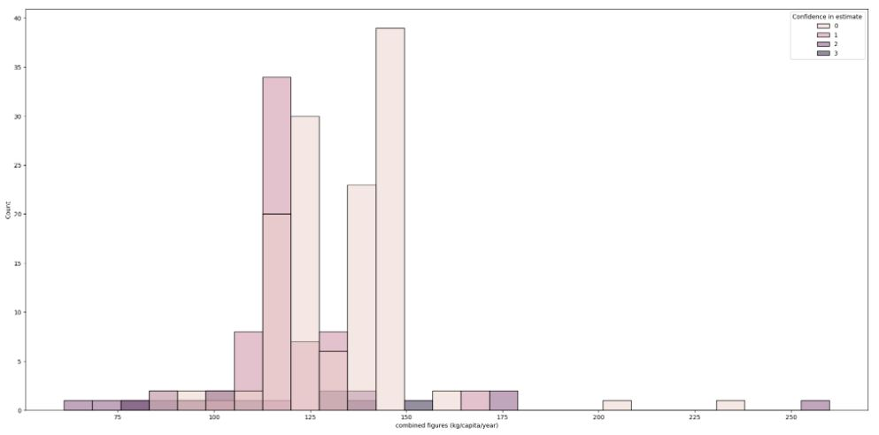
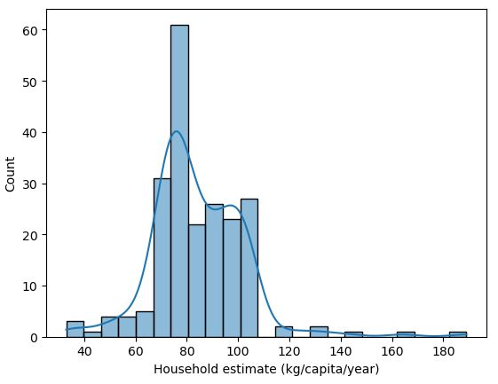
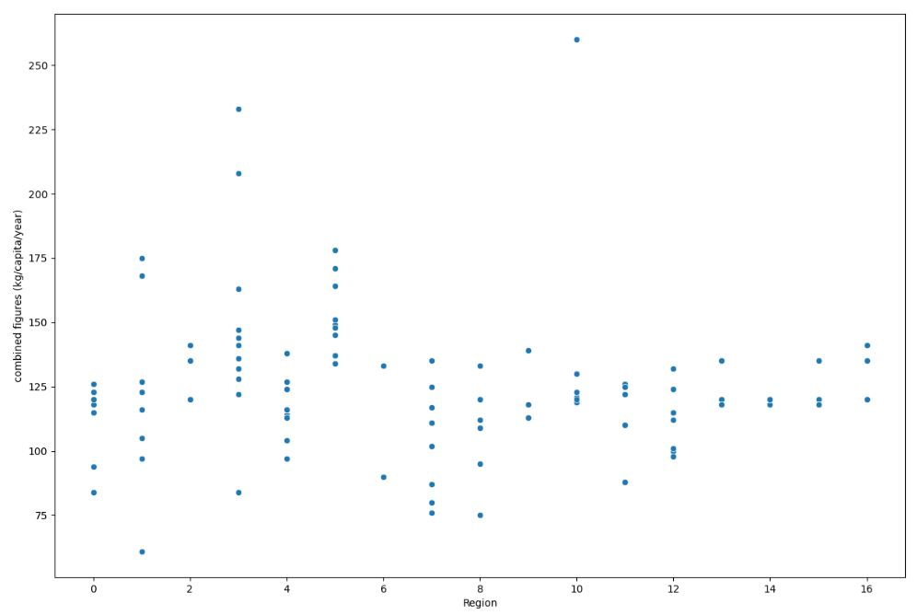
Data Analysis
Data Visualization:
Histograms: Used to visualize the distribution of data for different estimates (sns.histplot()).
Scatter Plot: Visualized the relationship between 'Region' and 'combined figures (kg/capita/year)' (sns.scatterplot()).

Slide 12
Data Analysis
Categorical Data Encoding:
Unique Values Mapping: Converted unique categorical values in the 'Region' column to numerical indices for easier analysis and visualization.
Key Findings:
The dataset has 214 rows and 12 columns.
The combined figures (kg/capita/year) column, along with the household, retail, and food service estimates, has been analyzed for mean and median values.
Unique categories in the 'Confidence in estimate' column have been mapped to numerical values.
Regions have been mapped to numerical indices.
Insights Derived:
The distribution of food waste across different categories (combined, household, retail, and food service) can be visualized using histograms.
The confidence level in estimates varies, with categories from very low to high confidence.
The scatter plot suggests a visual correlation between different regions and food waste figures, providing insight into regional variations in food waste data.

Slide 13
Hypothesis Development
Formulated Hypothesis: There is a significant difference in the average food waste across different regions, and this difference is influenced by the level of confidence in the estimates.
Rationale Behind the Hypothesis: The hypothesis is based on the observation that food waste levels vary by region due to differences in cultural practices, economic status, and food management policies. Additionally, the confidence level in the estimates could affect the reported figures, potentially reflecting varying levels of data accuracy and reliability across regions.
Method for Testing the Hypothesis
Data Collection and Preparation:
Load and inspect the data to ensure completeness and accuracy (pd.read_csv(), df.info(), pd.isnull()).
Map categorical data (such as 'Confidence in estimate' and 'Region') to numerical values for analysis (con_map, region_mapping).
2. Statistical Analysis:
Calculate descriptive statistics (mean, median) for food waste figures (mean(), median()).

Slide 14
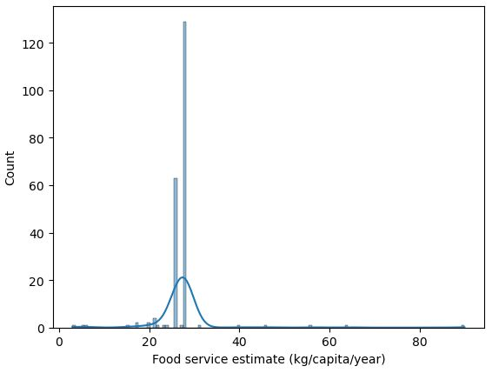
Hypothesis Development
Visualize the distribution of food waste across different regions and levels of confidence using histograms (sns.histplot()) and scatter plots (sns.scatterplot()).
3. Comparative Analysis:
Compare the means of food waste across regions using statistical tests (e.g., ANOVA) to determine if the differences are statistically significant.
Examine the influence of 'Confidence in estimate' on the reported food waste figures using grouped visualizations and descriptive statistics.
Conclusion: Interpret the results to see if the data supports the hypothesis, indicating significant regional differences in food waste and the impact of confidence levels on these differences.

Slide 15
Solution Design
Proposed Solution: The proposed solution is to identify and implement region-specific strategies to reduce food waste, taking into consideration the confidence level in the data estimates and the differences in waste generation across regions. This could involve targeted interventions at the household, retail, and food service levels.
Implementation Plan
Data Analysis and Insights:
Perform detailed analysis to identify key contributors to food waste in each region and at different stages (household, retail, food service).
Use visualizations and statistical analyses to communicate findings to stakeholders.
Stakeholder Engagement:
Collaborate with local governments, businesses, and communities to understand regional challenges and opportunities in food waste reduction.
Develop partnerships with organizations that can help implement waste reduction initiatives.

Slide 16
Solution Design
3. Intervention Design and Implementation:
Design region-specific intervention programs, such as educational campaigns, food donation systems, and waste tracking technologies.
Implement pilot programs in select regions to test the effectiveness of the interventions.
4. Monitoring and Evaluation:
Establish a monitoring framework to track the progress of interventions.
Use data analytics to assess the impact of the programs and refine strategies as needed.
5. Scaling Up and Policy Advocacy:
Scale successful interventions to other regions.
Advocate for policy changes based on data-driven insights to support sustainable food systems.
Alignment with SDGs:
The proposed solution aligns with the United Nations Sustainable Development Goals (SDGs) in several ways:

Slide 17
Solution Design
SDG 2: Zero Hunger: Reducing food waste can contribute to food security by ensuring that more food is available for those in need.
SDG 12: Responsible Consumption and Production: Implementing strategies to reduce food waste promotes sustainable consumption and production patterns.
SDG 13: Climate Action: Reducing food waste also contributes to climate action by minimizing the carbon footprint associated with food production and disposal.
By addressing these goals, the proposed solution aims to create a more sustainable and equitable food system.

Slide 18
Visualization
Data Visualization Techniques Used:
Histograms with KDE (Kernel Density Estimate) plots
Scatter plots
Charts, Graphs, Maps, etc.:
Histograms with KDE: Used to display the distribution of various estimates like 'combined figures (kg/capita/year)', 'Household estimate (kg/capita/year)', 'Food service estimate (kg/capita/year)', and 'Retail estimate (kg/capita/year)'.
Scatter Plots: Used to show the relationship between 'Region' and 'combined figures (kg/capita/year)'.
Key Visual Insights:
Distribution Patterns: The histograms with KDE plots help in understanding the distribution of food waste across different categories (household, retail, food service) and the overall combined figures. The KDE plots provide a smooth estimate of the distribution, highlighting peaks and patterns.

Slide 19
Visualization
Confidence Levels: The histogram with hue set to 'Confidence in estimate' shows the variation in data confidence levels across different food waste estimates. This visual insight helps in assessing the reliability of the data.
Regional Differences: The scatter plot illustrates how food waste, measured in 'kg/capita/year', varies across different regions. By mapping regions to numerical indices, the plot highlights regional trends and disparities in food waste levels.

Slide 20
Conclusion
Summary of Findings:
The dataset reveals significant variation in food waste per capita across different regions and categories (household, retail, food service). The mean and median values indicate a skewed distribution with higher values in certain areas.
Confidence levels in the estimates vary, with some data having low or very low confidence, suggesting potential inaccuracies or gaps in the data collection process.
Regional analysis shows distinct patterns in food waste, with some regions having consistently higher or lower waste figures.
Impact of Proposed Solution:
The proposed solution of targeted interventions to reduce food waste, informed by regional and category-specific data, can lead to more effective resource allocation and reduction strategies.
By focusing on areas with high waste and low confidence in data, the solution can address both the quantity of waste and the quality of information, leading to more accurate tracking and reporting.
The alignment with the SDGs, particularly Goal 12 (Responsible Consumption and Production), can contribute to broader global efforts to reduce waste and improve sustainability.

Slide 21
Conclusion
Future Work:
Data Improvement: Further data collection and validation are needed to improve the accuracy and confidence of the estimates, particularly in regions with currently low confidence levels.
In-Depth Analysis: More granular analysis of the factors contributing to high waste in specific regions or categories can inform tailored intervention strategies.
Monitoring and Evaluation: Implementing a monitoring system to track the impact of interventions over time and adjust strategies based on real-time data.
Public Awareness: Enhancing public awareness and engagement on food waste issues, leveraging the data insights to educate and encourage behavior change.

Slide 22
References
Data Sources: The data for this project will be collected from a variety of sources, including:
Government databases and reports
Agricultural and food production reports
Food waste studies and surveys
Non-governmental organizations (NGOs) and international organizations
Academic research and publications
Tools and Software Used: The data analysis for this project will be conducted using a variety of tools and software, including:
Python programming language and libraries, such as NumPy, pandas, and scikit-learn
Data visualization tools, such as Matplotlib and Seaborn
Statistical analysis software, such as R and SAS
Geographic Information Systems (GIS) software, such as ArcGIS and QGIS

Slide 23
References
Additional References: The following references will be used to guide the data analysis and interpretation for this project:
Food and Agriculture Organization of the United Nations (FAO)
United Nations Sustainable Development Goals (SDGs)
World Health Organization (WHO)
World Bank
International Food Policy Research Institute (IFPRI)

